Slide 1
Meeting 10
Tuesday 27/03/2018

Slide 2
Agenda
LES
Wind turbine and output
LES output
Turbulence intensity
Wind profile
Inflow profile
Comparison WMR & LES wind speeds
Horizontal profile
Next steps
Midterm meeting

Slide 3
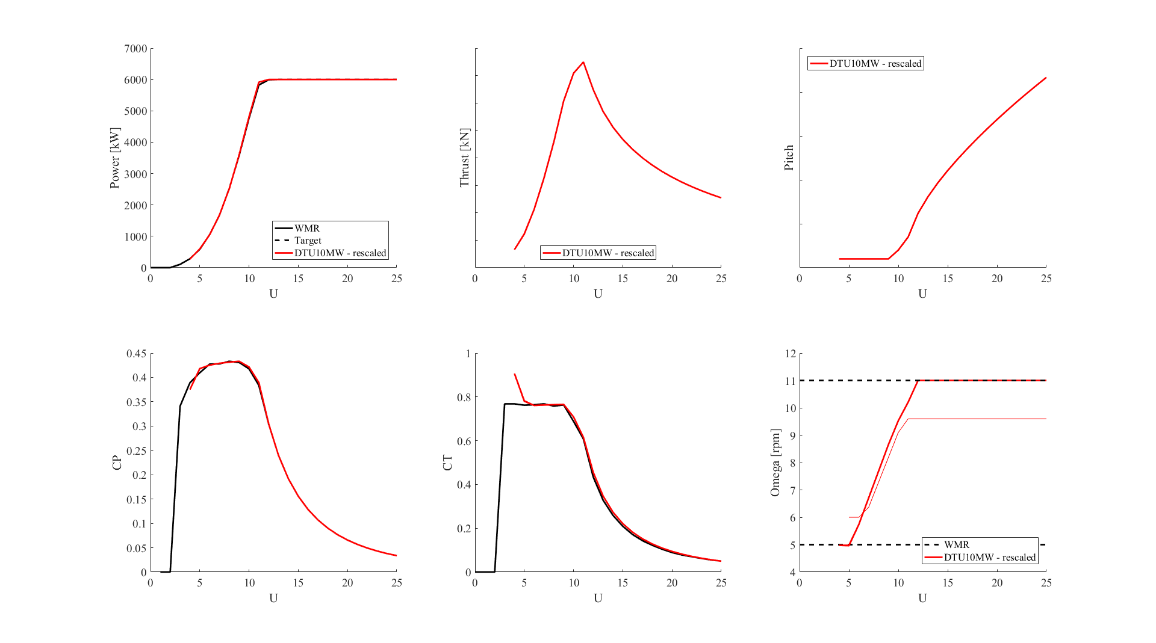
1a. LES Wind turbine
Notes:
DTU10MW turbine scaled (red) to WMR wind turbine (black): matches very close

Slide 4
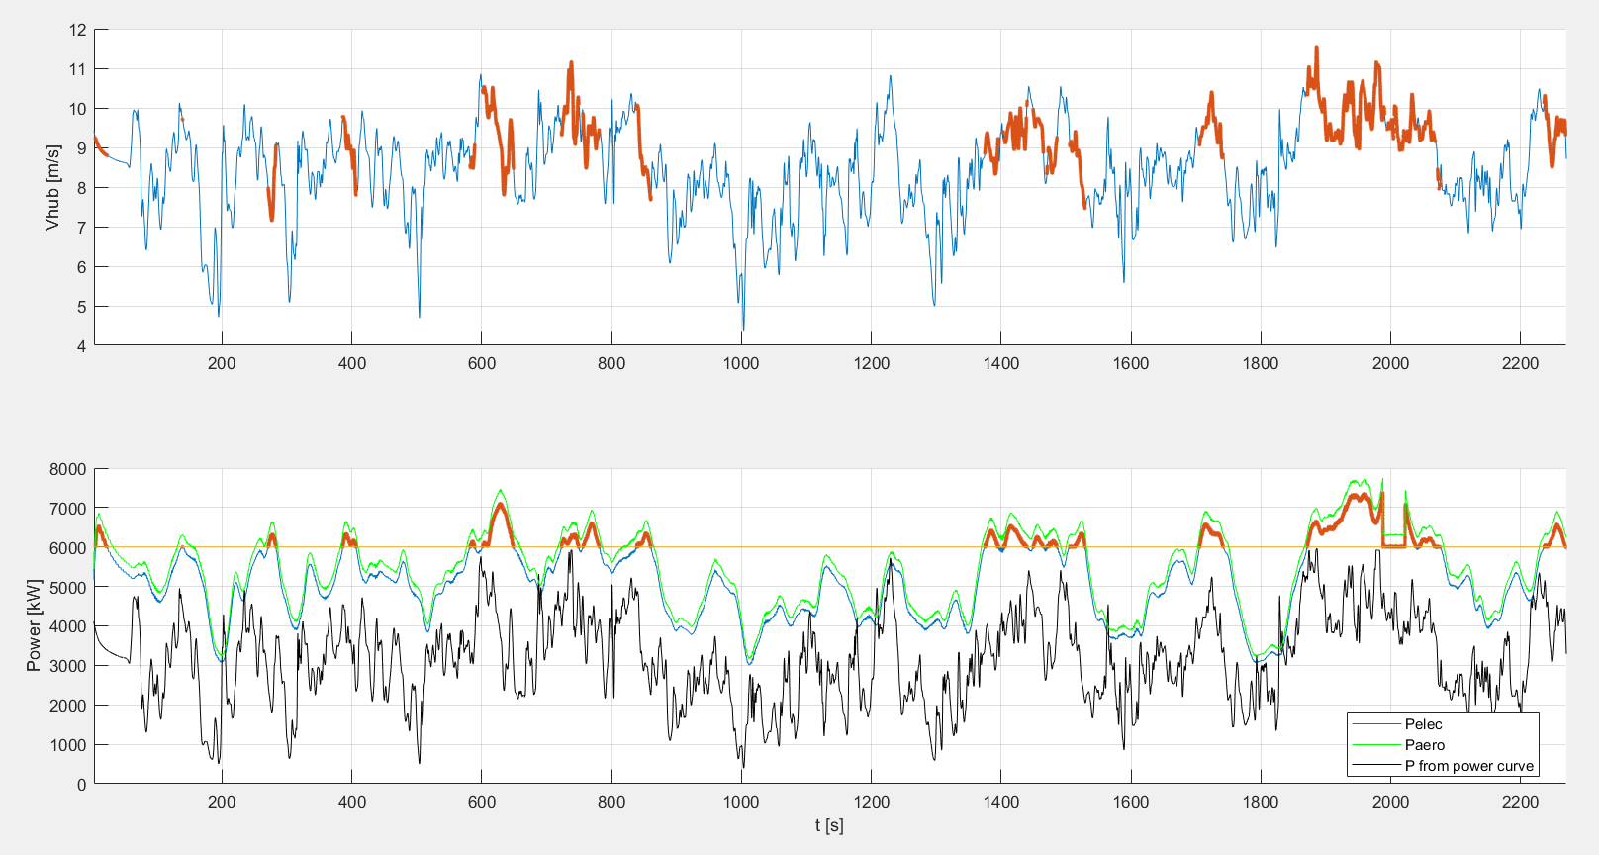
1b. LES output (Case 3)
Notes:
1st figure: Vhub = wind velocity at hub height, 1R upstream of 1st wind turbine
Black power curve: power derived from Vhub and power curve
The electrical power (Pelec) is exceeding Prated, up to 7MW and for long time periods These points in time are indicated in orange (both in the power curve as for Vhub)
Reasons why the black power curve is lower than the blue one: induction, shear, steady state power curve
Mean ( Pelec / Pfrom power curve)=1,844

Slide 5
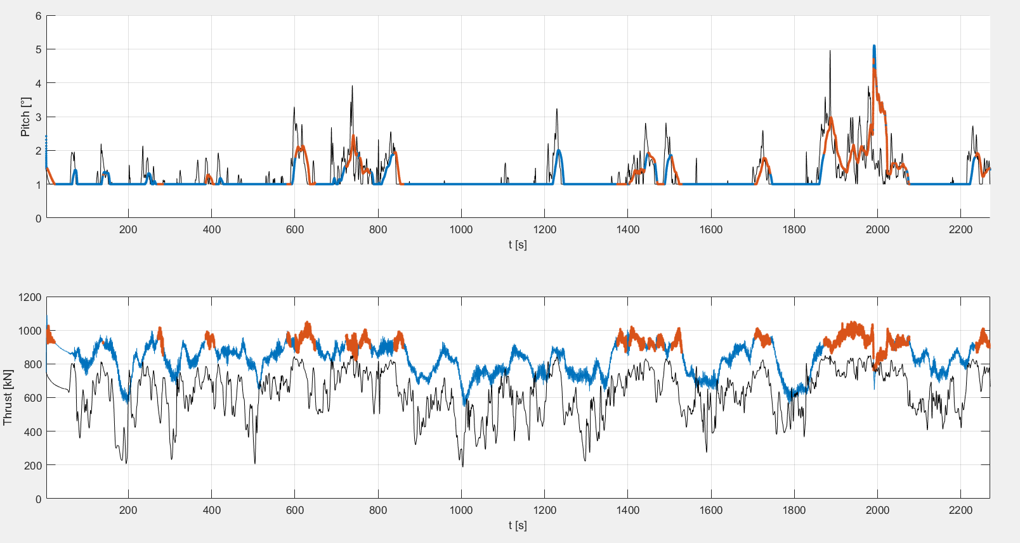
1b. LES output(Case 3)
Notes:
Black curves: interpolated values making use of Vhub and pitch/thrust curve
Orange: when Pelec exceeds Prated
Pitch behaves as expected
Thrust is too high in LES simulations! Because of intertia you gain a bit extra thrust, but not this much

Slide 6
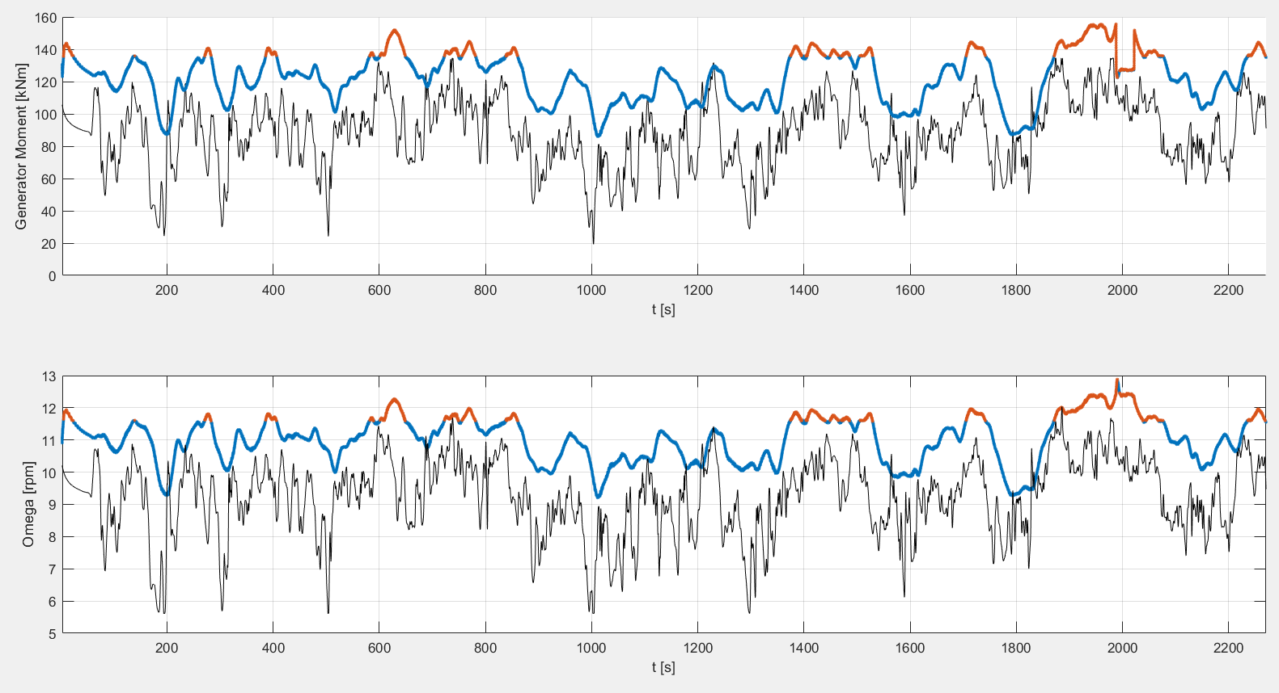
1b. LES output(Case 3)

Slide 7
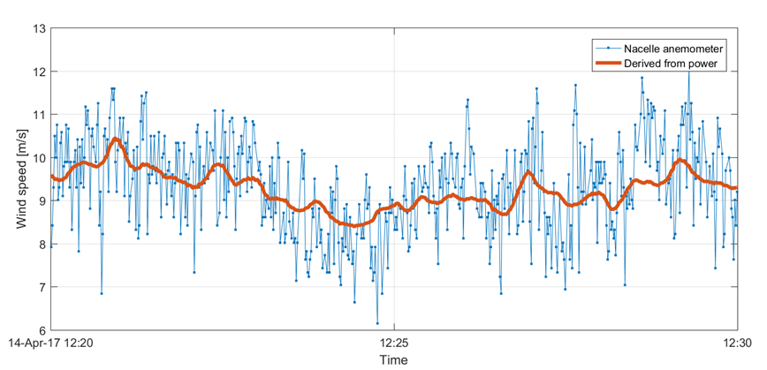
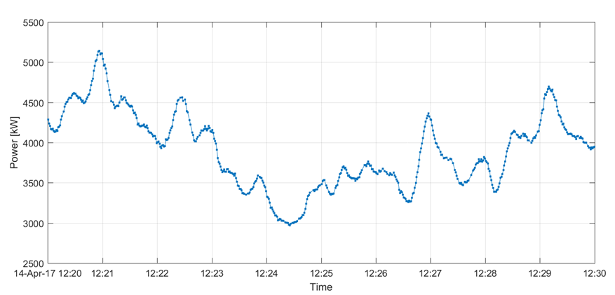
2. Turbulence Intensity BEACon (Case 3)
Nacelle anemometer and power production of wind turbine A01
The TI based on the nacelle anemometer over this 10-minute period is 11.7%.
The TI based on the wind speed derived from the power data is only 4.6%.
(Calculations by Nicolai)
Notes:
Power curve: “averaged” value, does not react instantaneously → lower TI

Slide 8
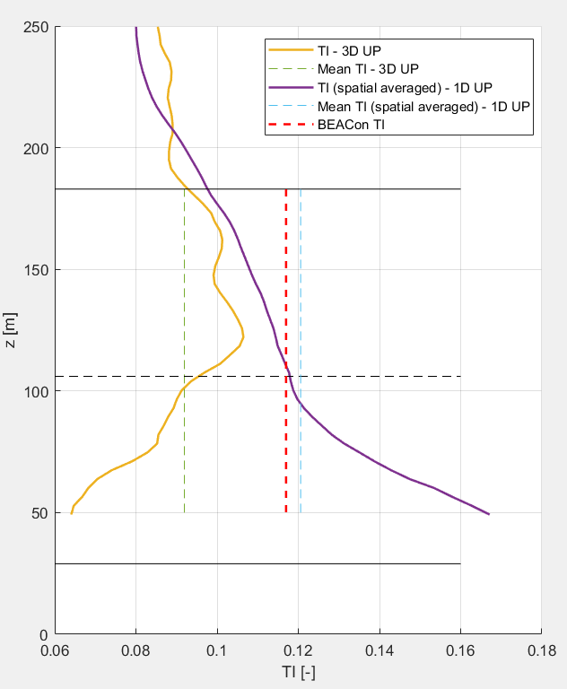
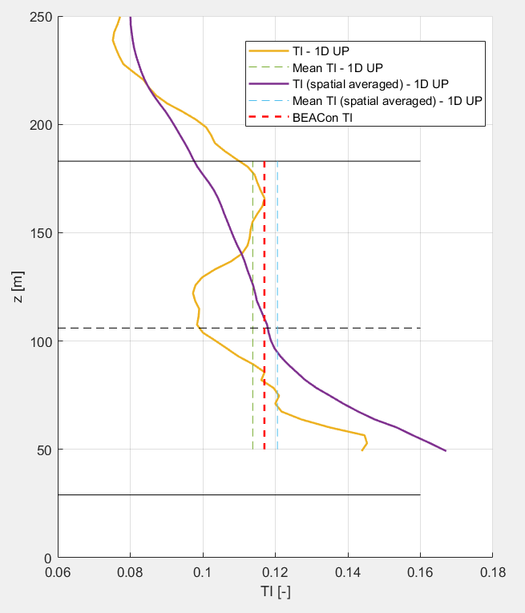
2. Turbulence Intensity LES (Case 3)
TI based on 10-min averages
Turbulence is imposed in planes at 3,95D upstream of the first turbine
TI calculated at different positions downstream
Notes:
Cross-strea planes for LES are only available up to 1D upstream (see also next slide)
Purple line: LES turbulence, also averaged in space
TI in LES is created with body forces
Matches TI at hub height quite well with the BEACon TI
Could be tuned up a little bit in the LES situations, but will not make a big difference

Slide 9
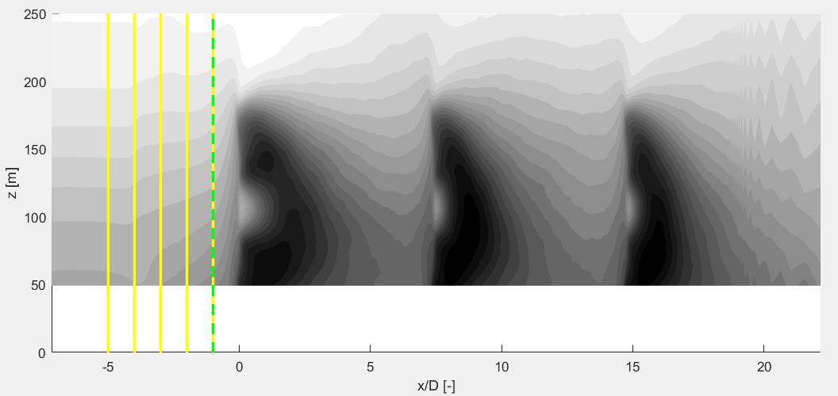
3a. Inflow wind profile
Inflow profile BEACon: spatial averaged velocity (cross-stream plane)
Inflow profile LES
Yellow: data only from one line
Yellow-green: spatial averaged velocity (cross-stream plane)
Notes:
Cross-stream planes for LES are only available up to 1D upstream

Slide 10
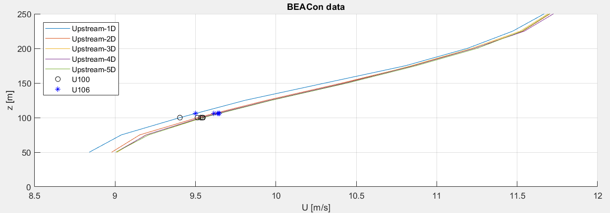
3a. Inflow wind profile: BEACon
Difference Wind speed at 100m and 106m
U0 is actually at 100m –> gives already too low input velocity for LES
Spatial averaged inflow wind profile (Case 3)
Notes:
9,5m/s is used as inflow velocity at hub height (106m), but is actually at 100m → Inflow wind speed of LES simulations should be increased

Slide 11
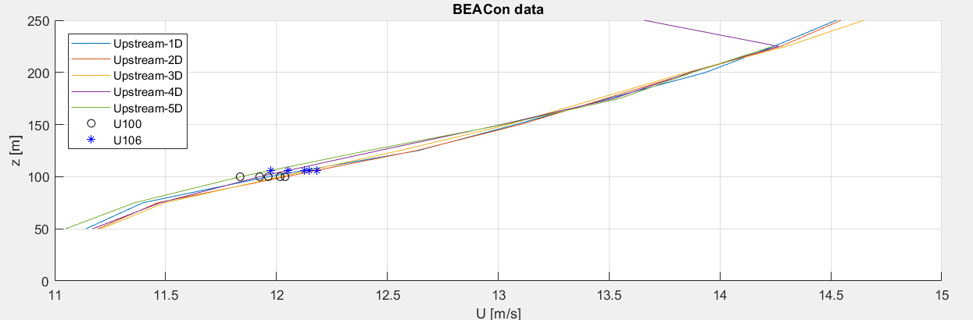
3a. Inflow wind profile: WMR
Spatial averaged inflow wind profile (Case 1)
Notes:
11,8m/s is used as inflow velocity at hub height (106m), but is actually at 100m → Inflow wind speed of LES simulations should be increased

Slide 12
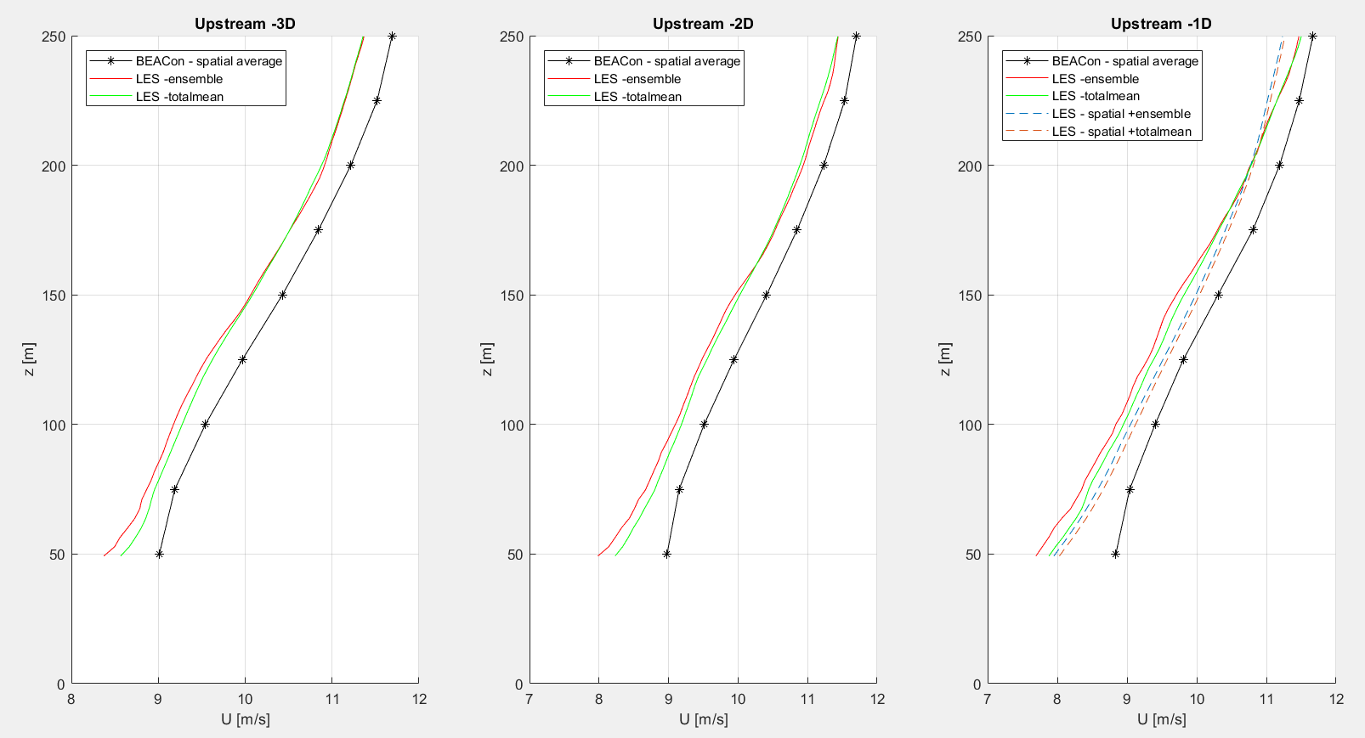
3a. Comparison WMR & LES wind profiles (Case 3)
Inflow profiles at different upstream positions
Where do we want to match them?
Notes:
Different ways of calculating LES time average
Ensemble (as shown previous meeting)
Total mean: mean of all values (after transien)
The difference between the LES and BEACon profiles is +- constant for different locations upstream (due to wind speed at 100m used instead of 106m)
For -1D upstream also data of cross-stream plane available: also spatial averaging

Slide 13
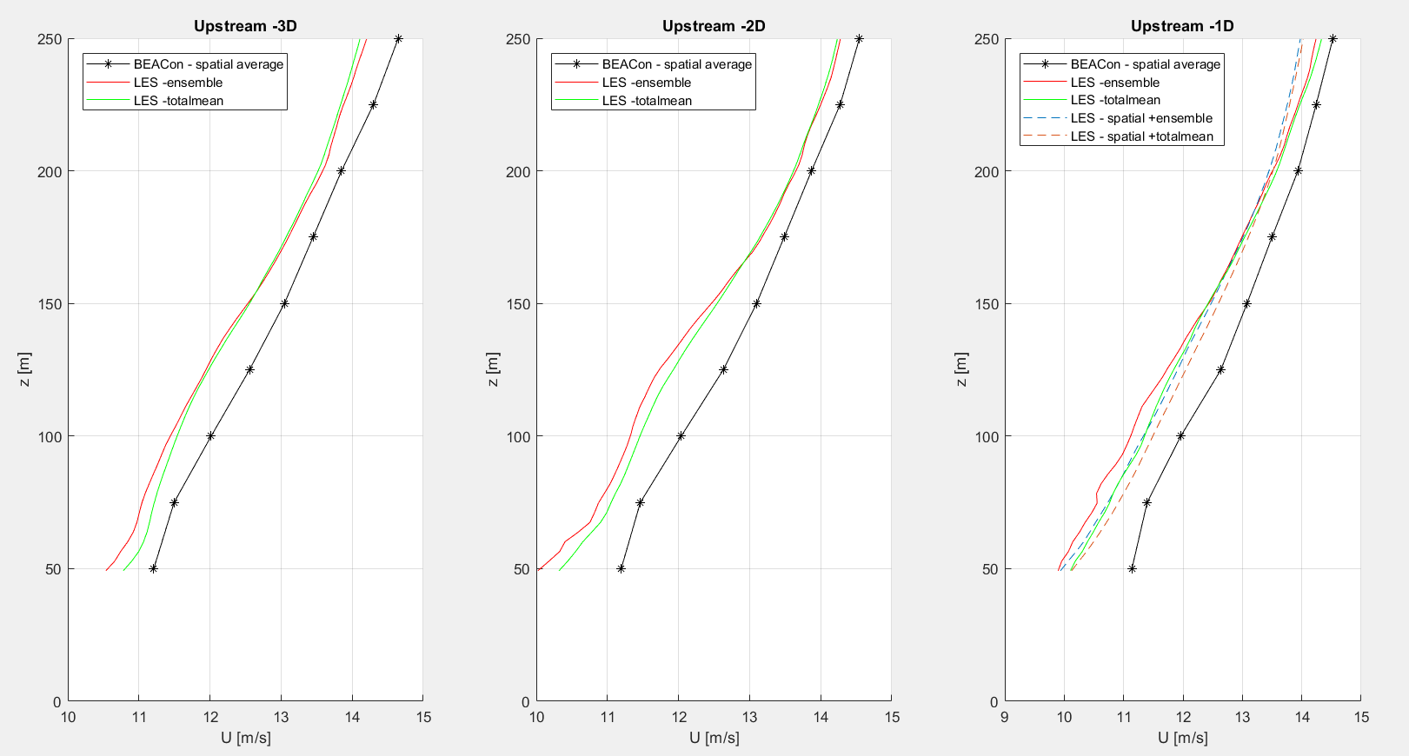
3a. Comparison WMR & LES wind profiles (Case 1)
Inflow profiles at different upstream positions
Where do we want to match them?

Slide 14
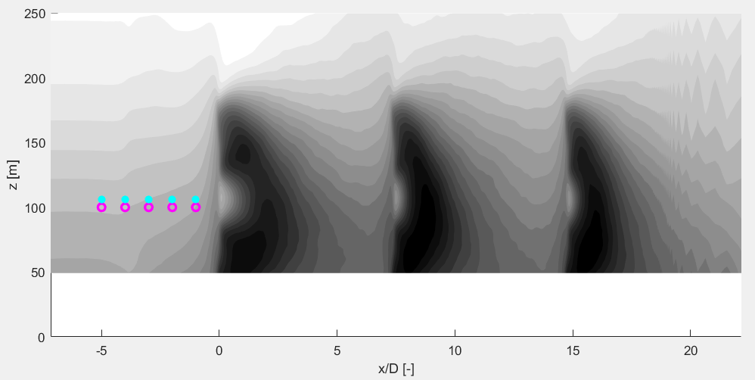
3a. Inflow wind profile
Inflow profile BEACon: spatial averaged velocity (cross-stream plane)
Inflow profile LES: data only from one point
Blue: 106m height (hub) Pink: 100m height
Notes:
Wind speeds at 100m
Wind speeds at 106m
Upstream locations: -5D, -4D, -3D, -2D and -D

Slide 15
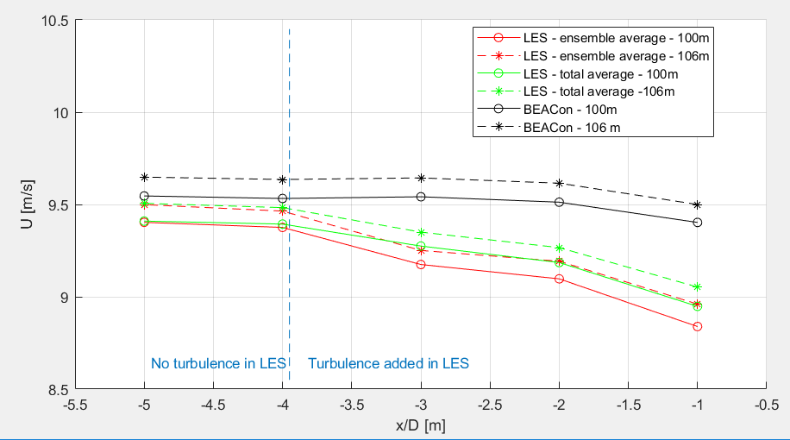
3b. Comparison WMR & LES wind speeds
Wind speed at 100m and 106m: BEACon and LES
Case 3
Notes:
The LES wind speeds far upstream are too low As a comparison they are scaled with the log law in the next slide

Slide 16
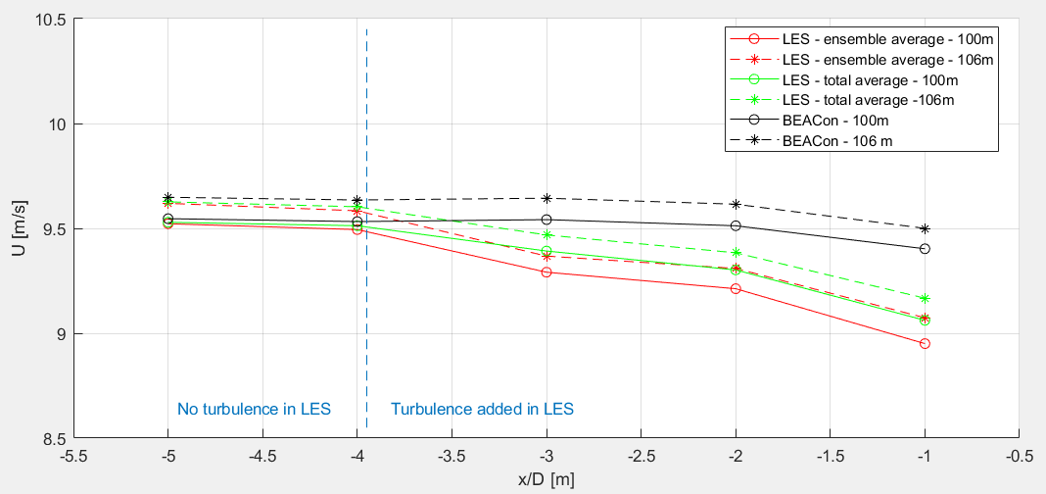
3b. Comparison WMR & LES wind speeds
Wind speed at 100m and 106m: BEACon & LES with scaling (log(106)/log(100))
Case 3
Notes:
- The scaling is not used to scale all LES results! This is just an indication that the inflow wind speed for the LES data should be increased

Slide 17
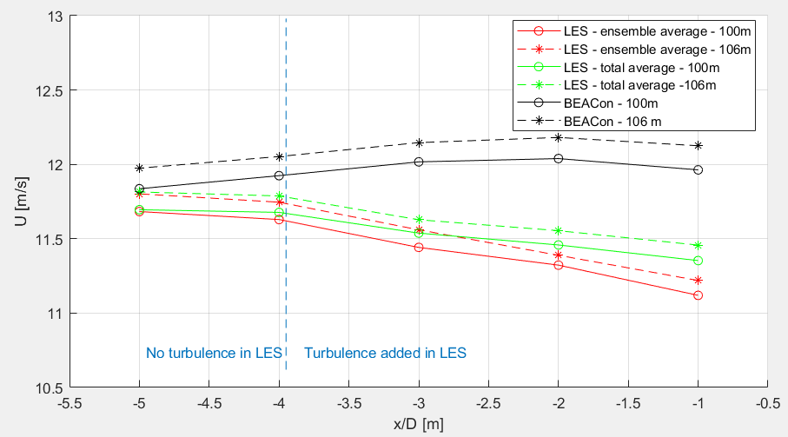
3b. Comparison WMR & LES wind speeds
Wind speed at 100m and 106m: BEACon and LES
Case 1

Slide 18
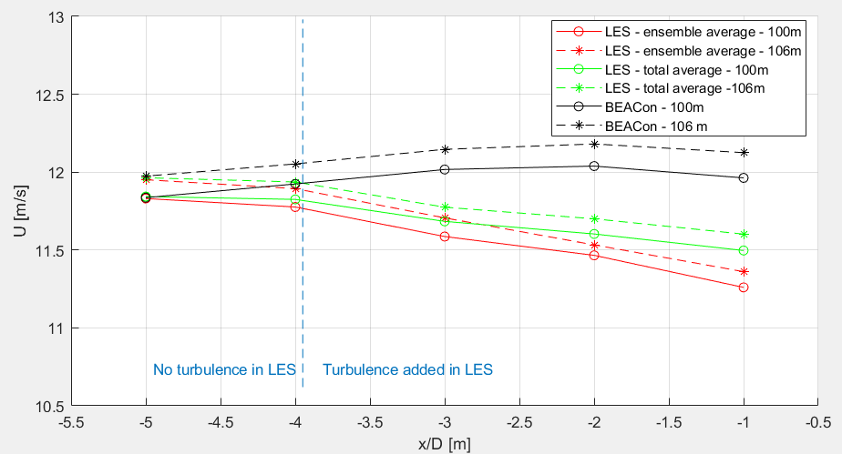
3b. Comparison WMR & LES wind speeds
Wind speed at 100m and 106m: BEACon & LES with scaling (log(106)/log(100))
Case 1

Slide 19
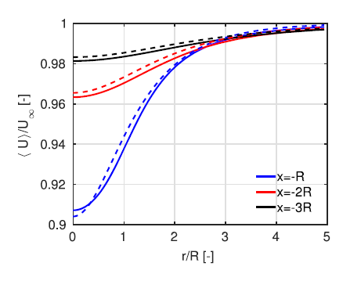
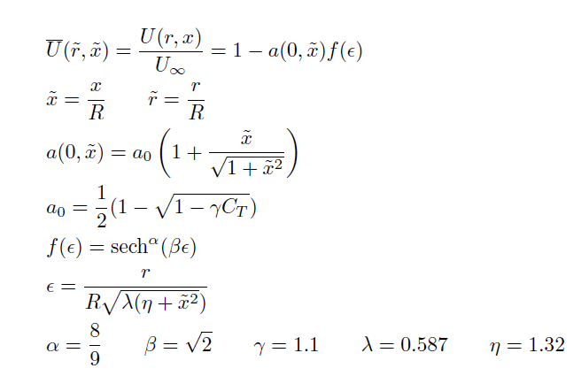
3b. Comparison WMR & LES wind speeds + simple model induction
A simple model of the wind turbine induction zone derived from numerical simulations – N.Troldborg et al.

Slide 20
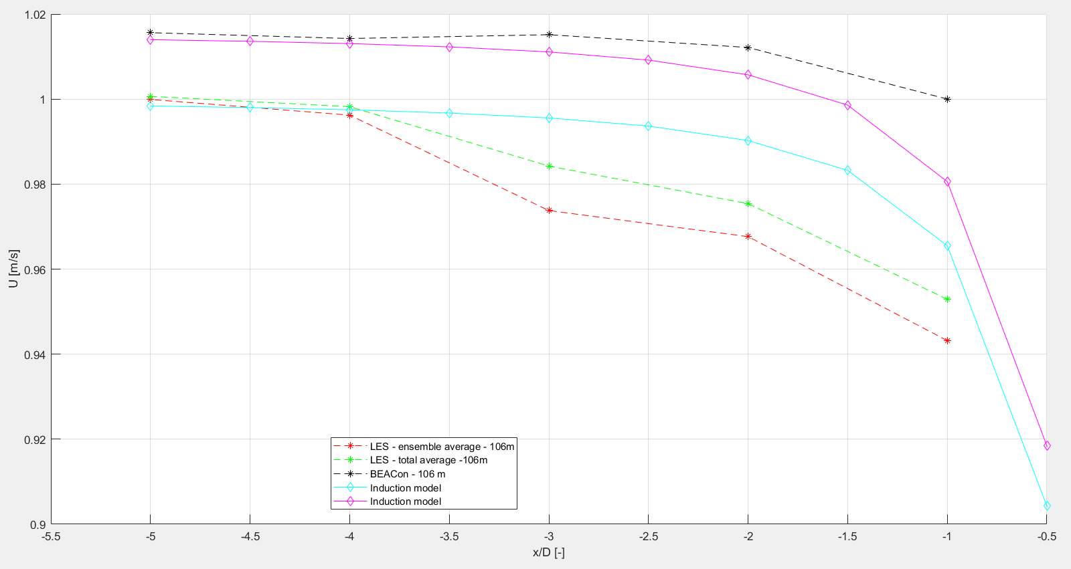
3b. Comparison WMR & LES wind speeds + simple model induction (Case 3)
Notes:
Normalized with Uo=9,5 m/s
The induction model

Slide 21
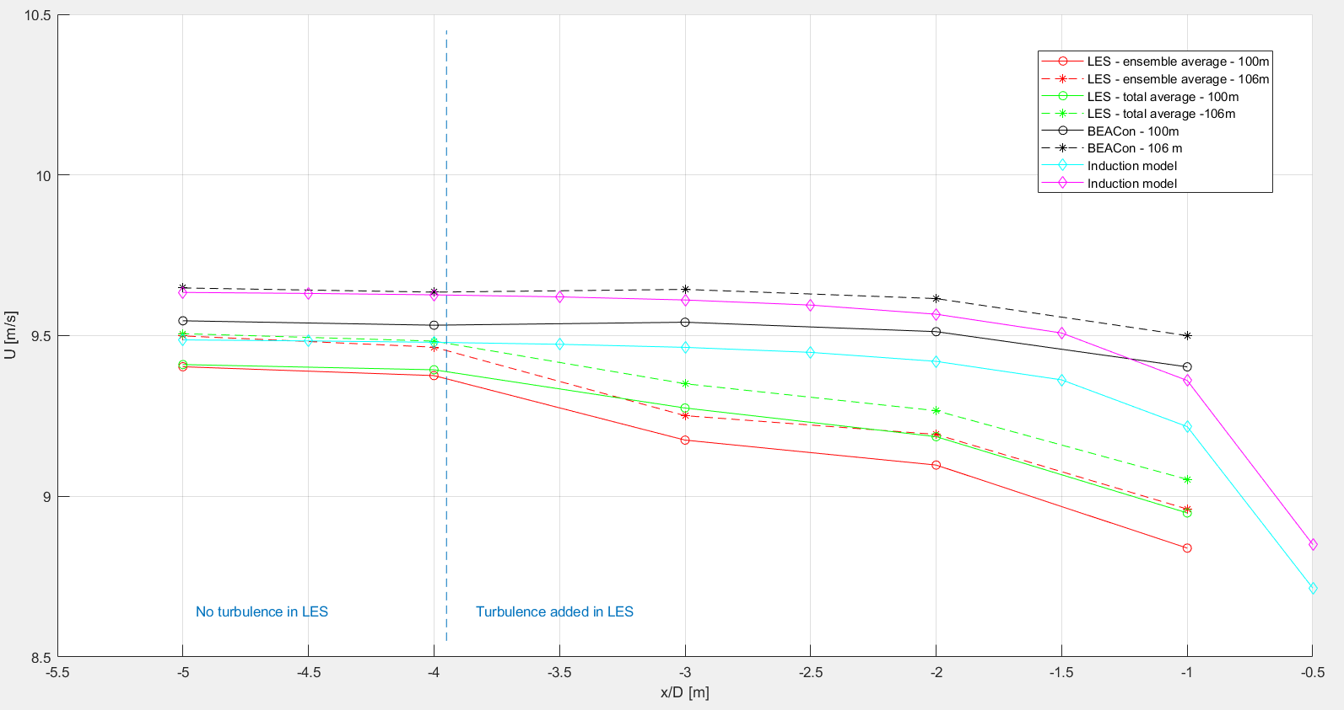
3b. Comparison WMR & LES wind speeds + simple model induction (Case 3)
Notes:
Non-normalized for Case 3

Slide 22
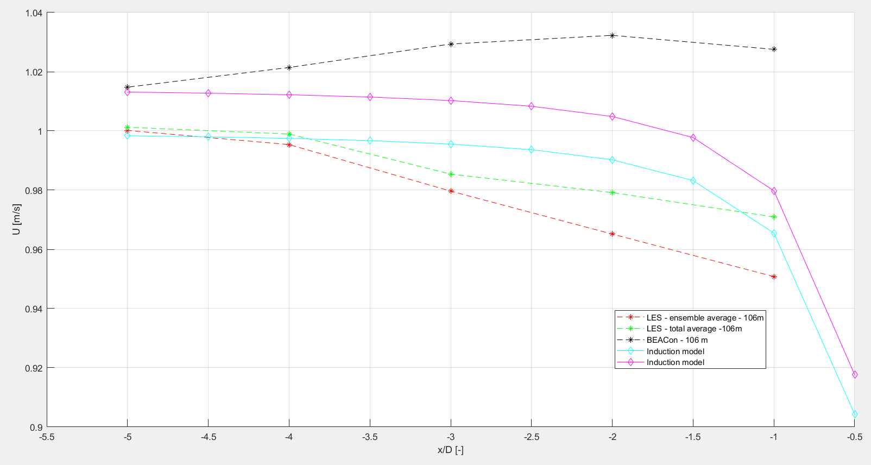
3b. Comparison WMR & LES wind speeds + simple model induction (Case 1)
Notes:
Normalized with Uo=9,5 m/s
The induction model

Slide 23
4. Horizontal profile
WMR: at 100m height
LES
at 100,24 m and 107,53 m height
Spatial averaged at 100 m height

Slide 24
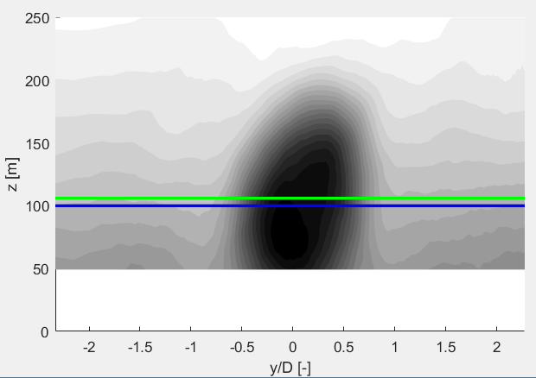
4. Horizontal profile
Notes:
At different downstream positions

Slide 25
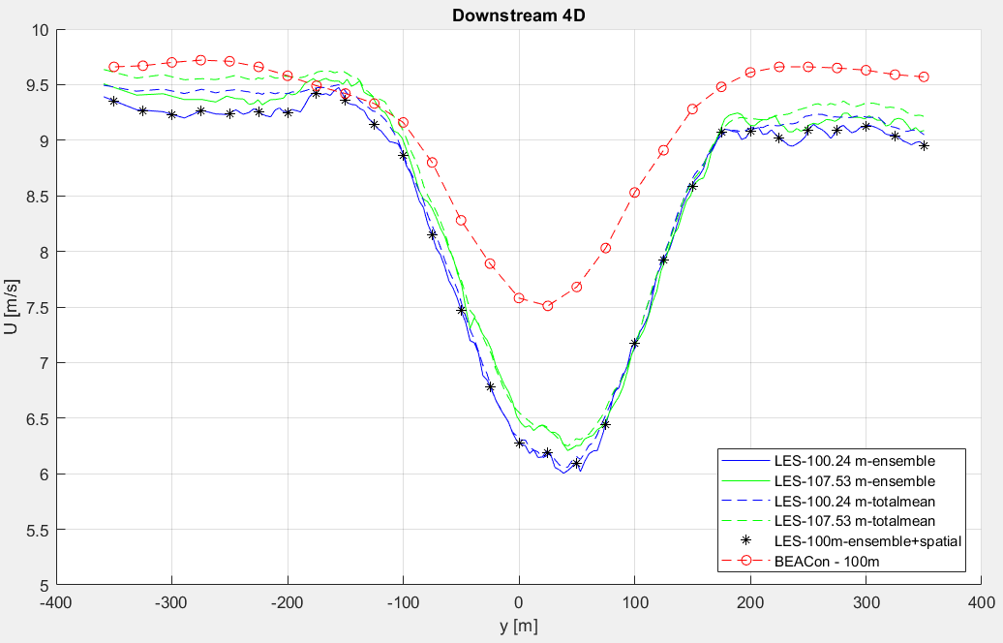
4. Horizontal profile
Notes:
The spatial averaging has a very limited effect: do not worry about this
Blue(/black) and red curve should be compared
BEACon profile is very smooth
Suggestion: make error bar around mean WMR (now only mean plotted)

Slide 26
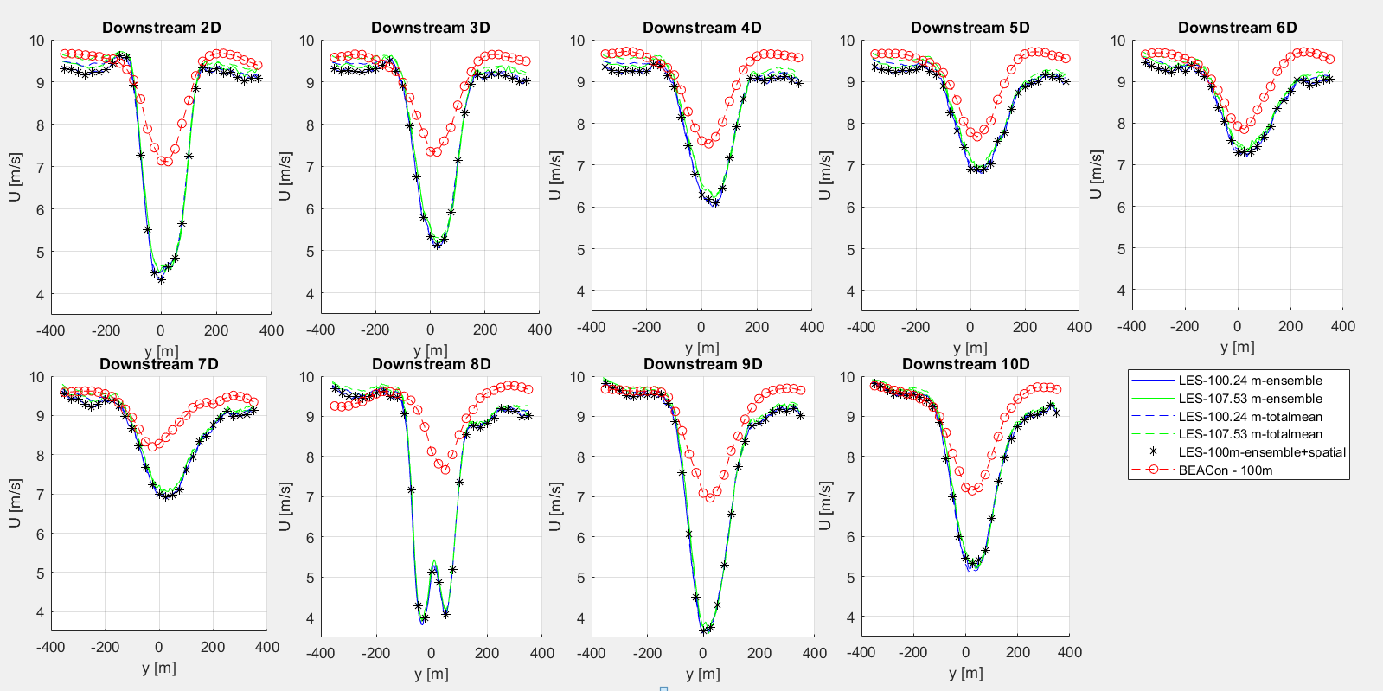
Notes:
Compare black and red curves

Slide 27
Next steps
New LES simulations
Turbulence Intensity
Inflow wind speed
Power spectrum (Nicolai)
Superposition of LES results
Comparison wind field 1WT and wind field 3WT
Notes:
Detect (to seperate questions/conclusions):
Super position
Single wake induction
Focus on horizontal plane (at 100m)
Mean
Cross-correlation in time for each point (1WT // 3WT)
Look which superpostion method (linear, quadratic, max deficit) is closest to the LES results. Or another method/scaling used?

Slide 28
Midterm meeting
Monday 16/04, 9:30-10:30
Calendar invitation
15-20 min presentation + questions
Draft report
Next meeting? (Tuesday 10/04 at 14:00)
Notes:
During midterm meeting not the time to discuss as much in detail as we can do during the normal meetings
Midterm: everything that has been done + what the big next steps are (planning)
Midterm draft report: the people who don’t know until now what I’ve been doing, should have an understanding of what the thesis is about

